Slide 1
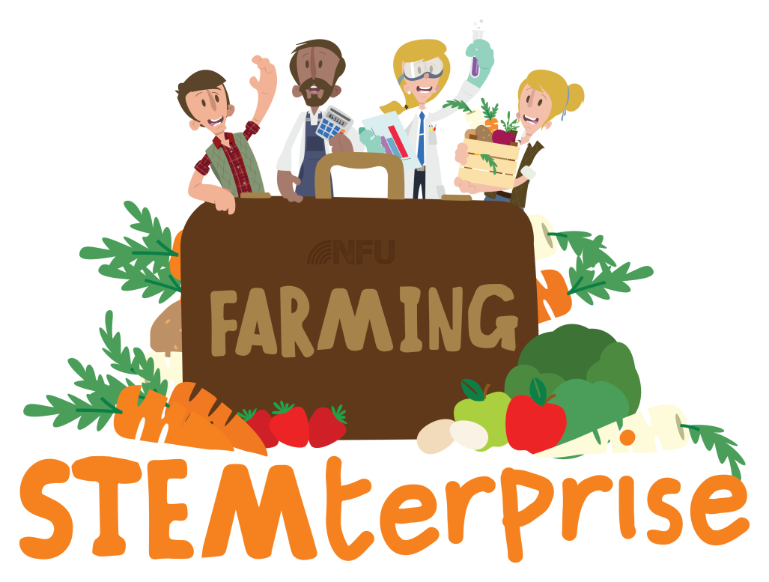
Stage 4: Growing our own ingredients without seeds

Slide 2
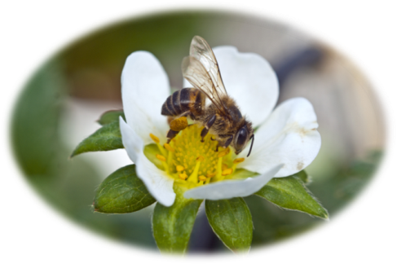
Learning Objective:
To explore ways in which plants reproduce without seeds
Talk to your partner:
Thinking back to stage 2, what needs to take place for seeds to be produced?
Can you think of any problems that this might cause?
Why might it be useful for plants to reproduce without producing seeds?

Slide 3
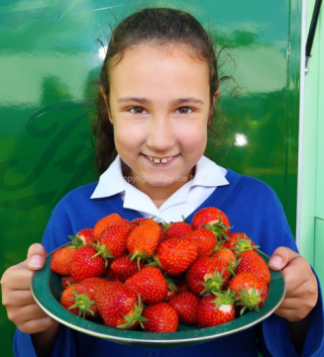
Asexual reproduction in plants
Plant reproduction using seeds is known as sexual reproduction as it involves female and male cells.
Some plants reproduce using asexual reproduction which means that only one parent plant is required and, as a result, the offspring plants are genetically identical to the parent and to each other (they are clones).
One of the most amazing things about plants is that every part has the ability to grow into a new clone of the original plant with all its parts and functions. Let’s look at strawberry plants to see an example of how this works.

Slide 4
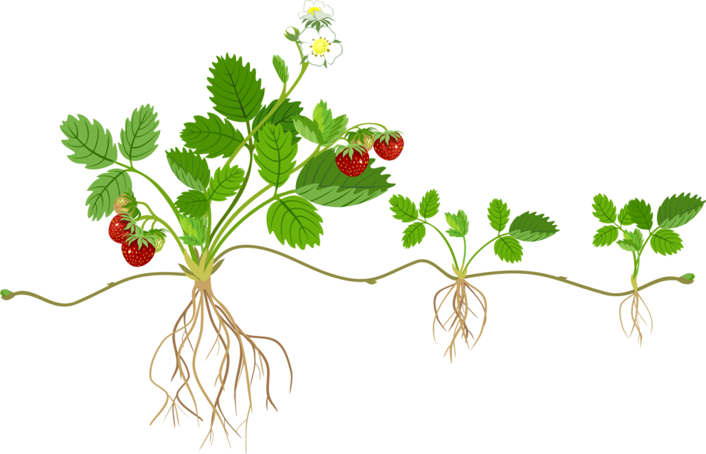
Strawberry plant propagation
Strawberry plants grow runners in order to produce new plants. Runners are offshoots of the parent plant with their stems growing along the ground. Where the runners make contact with the soil, nodes appear. From each node, a daughter plant can develop, complete with roots and leaves. This daughter plant will be a clone of the parent plant.
Parent plant
Node
Runner
Daughter plants

Slide 5
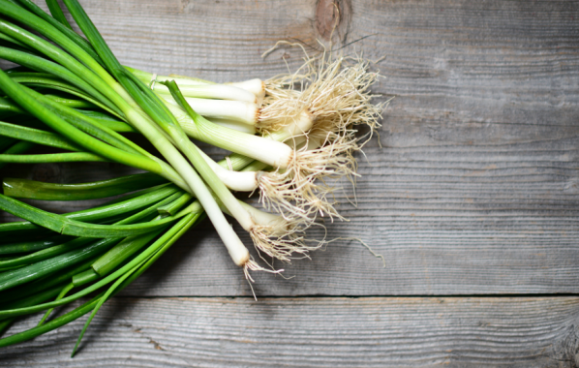
Task 1: Practical exploration
Asexual reproduction can occur naturally but it is more often used by crop growers to produce a large amount of crops quickly. We can also help a plant reproduce (and grow some more yummy vegetable ingredients to use in our recipes) by taking cuttings and creating the right conditions to create entirely new plants.
We are going to use our knowledge of asexual reproduction to grow some new spring onions from the roots of a parent plant. You can then use our new produce in the recipes you will create in a future lesson.

Slide 6
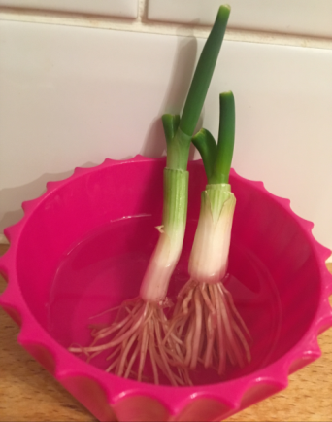
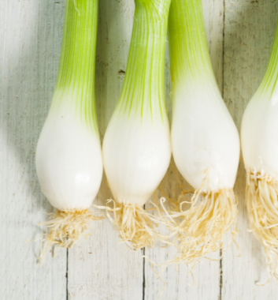
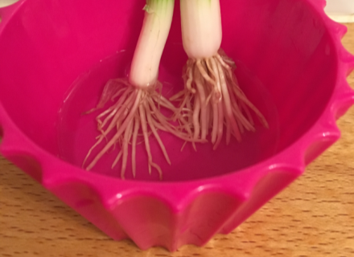
Re-growing spring
onions
Step 2: Place them in a shallow bowl of water
Step 1: Cut the root ends off some spring onions
Step 3: Replace the water every day and watch your new onions grow!

Slide 7
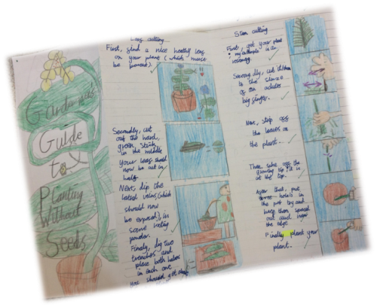
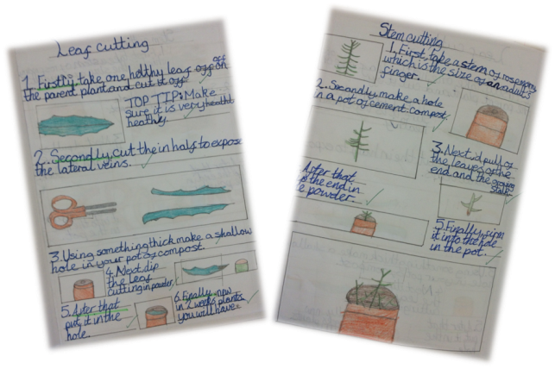
Task 2: Independent research
Research some methods of plant propagation that we have not discussed yet.
Use your research to write a ‘How to’ gardeners’ guide to help new gardeners get started on growing their own ingredients without seeds.
Remember to use all the features of instruction texts and illustrate each step of your methods.
You might like to present your guide as mini-booklet, leaflet, power point or video.

Slide 8
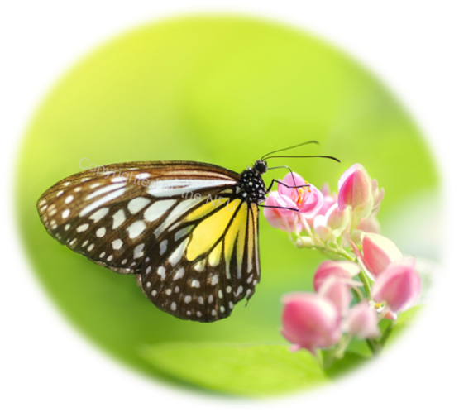
Thinking Critically
In you groups, think carefully and consider the advantages and disadvantages of both sexual and asexual reproduction in plants.

